Slide 1
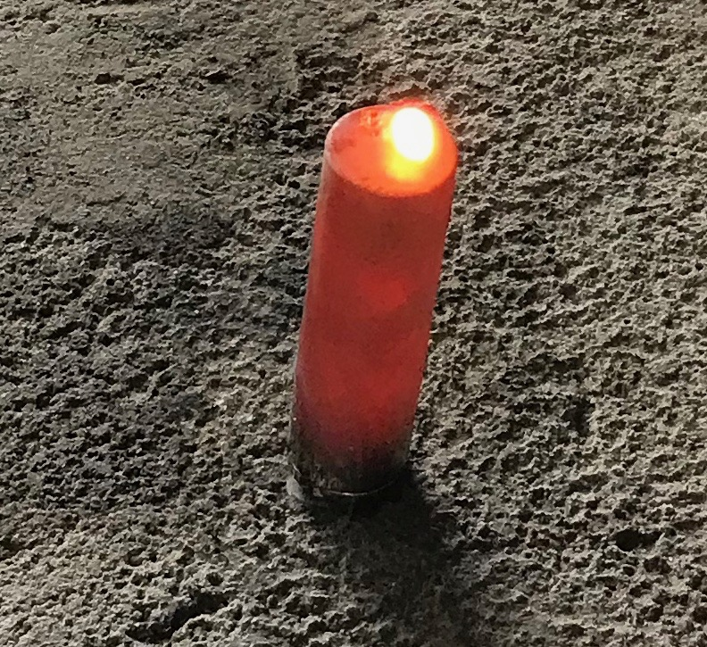
On measuring energy from Li-ion batteries in runaway and combustion
J. G. Quintiere
Qdot LLC with VTEC Labs.
sponsored by PHMSA

Slide 2
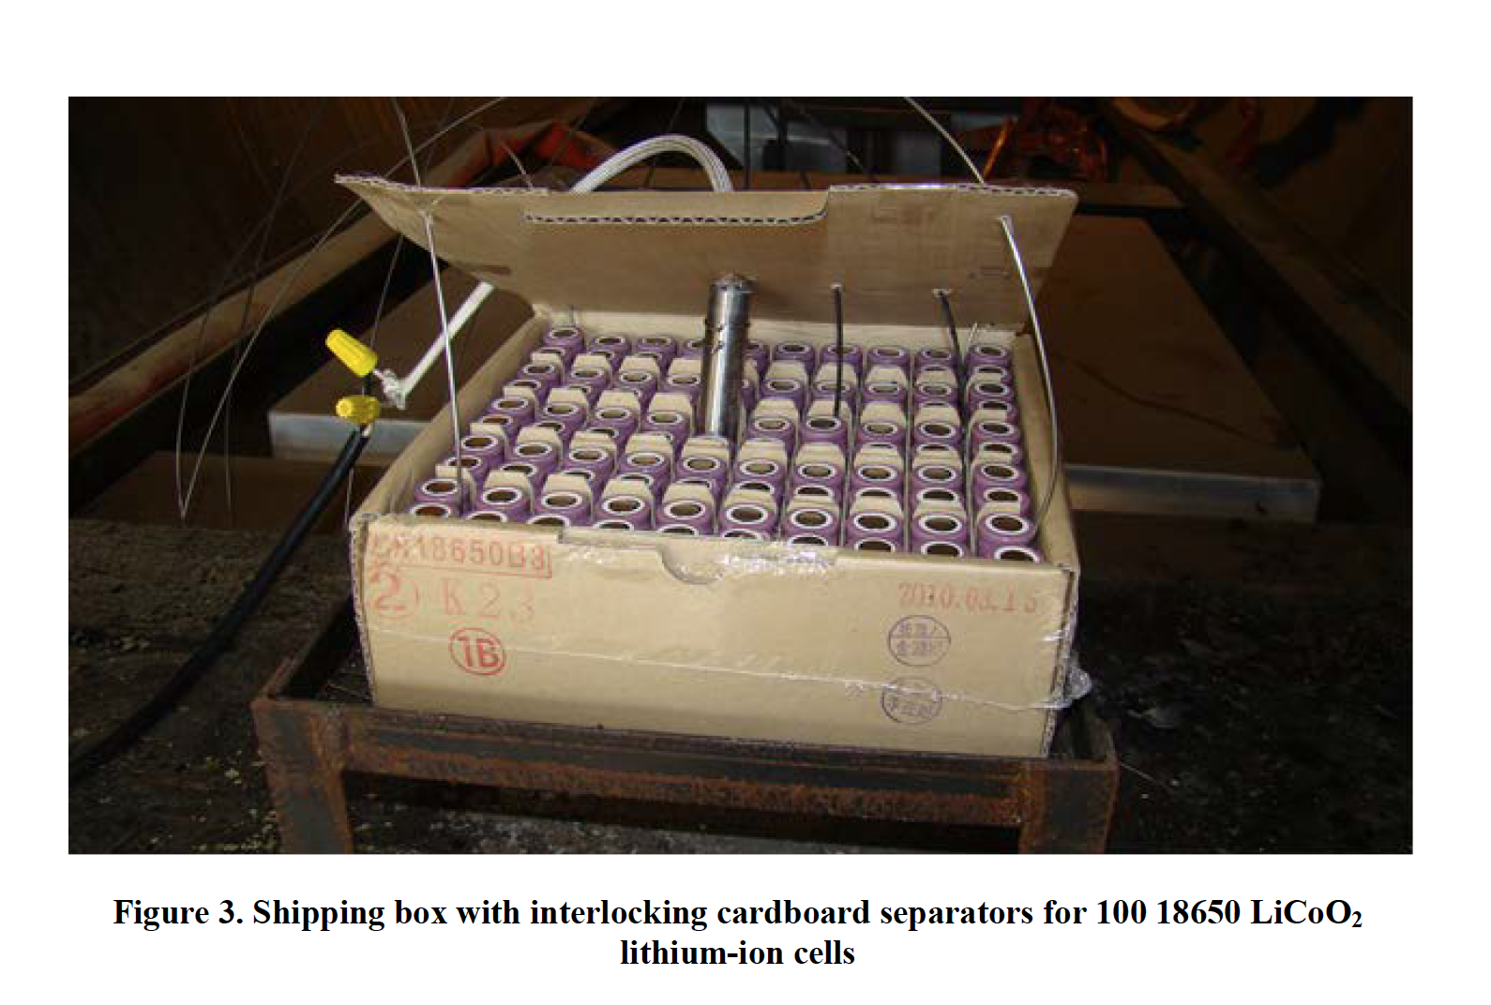
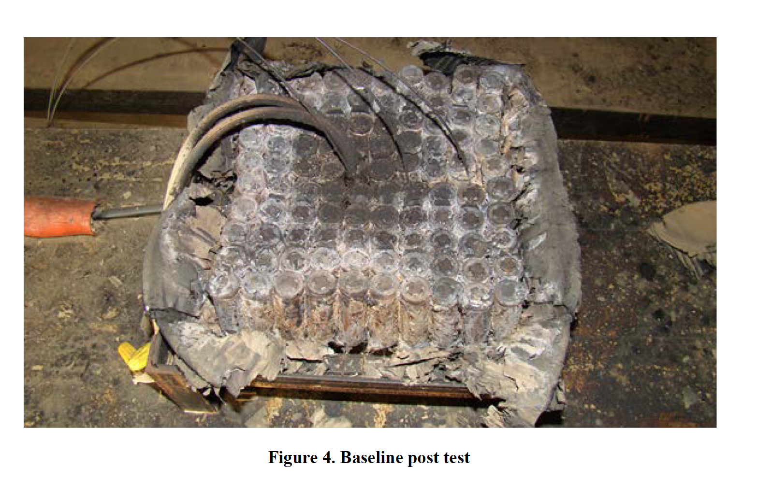
Objective
Measure energy produced during “Runaway”
Runaway: Rapid exothermic release of electro-chemical energy
Results
  High temperature
  Combustion
  Hot debris
Design safe packaging
All cells propagated within 30 minutes with flaming

Slide 3
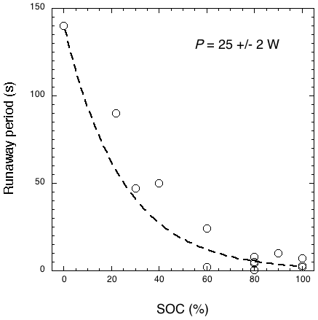
Two forms of energy
Runaway energy: Exothermic decomposition and Ohmic heating
Combustion energy: Release of flammable gases: Hydrogen, Carbon monoxide, Hydrocarbons.
Why measure only energy?
  Runaway process is very fast

Slide 4
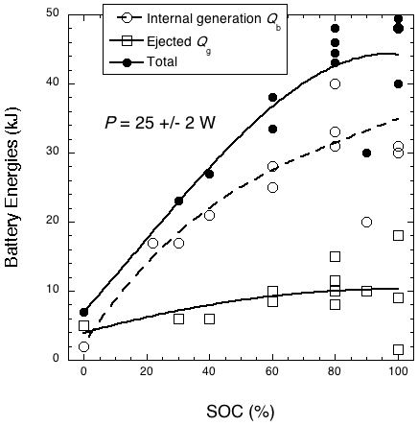
Energy release depends on electric capacity
Both combustion and exothermic runaway energy depend on the State of Charge (SOC)
SOC in % or Watt-hour is the available electric battery energy

Slide 5
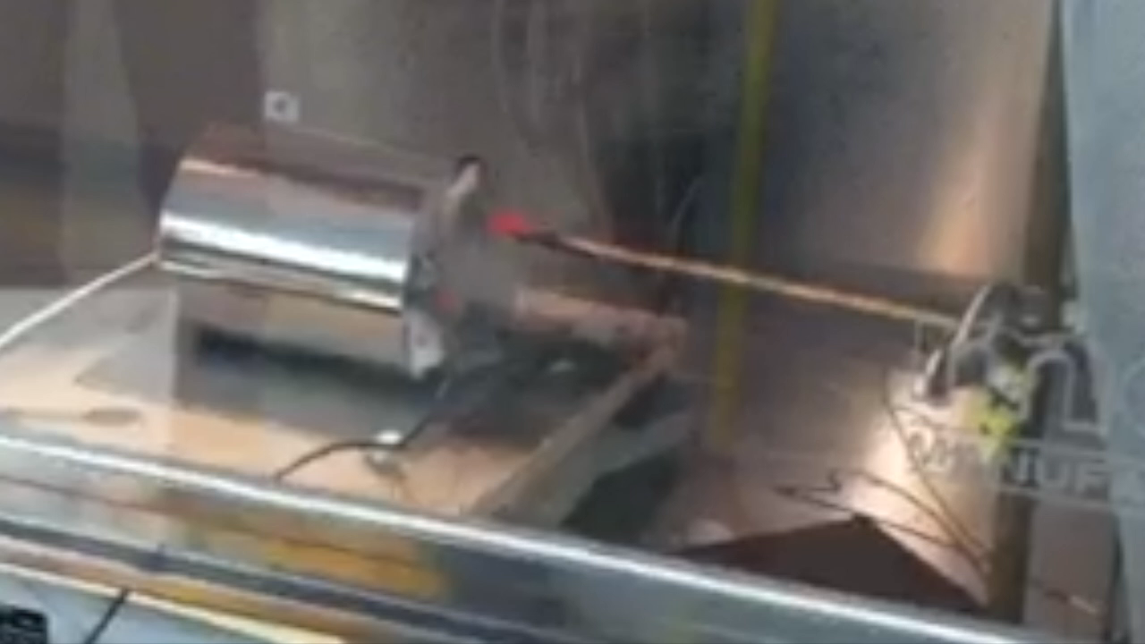
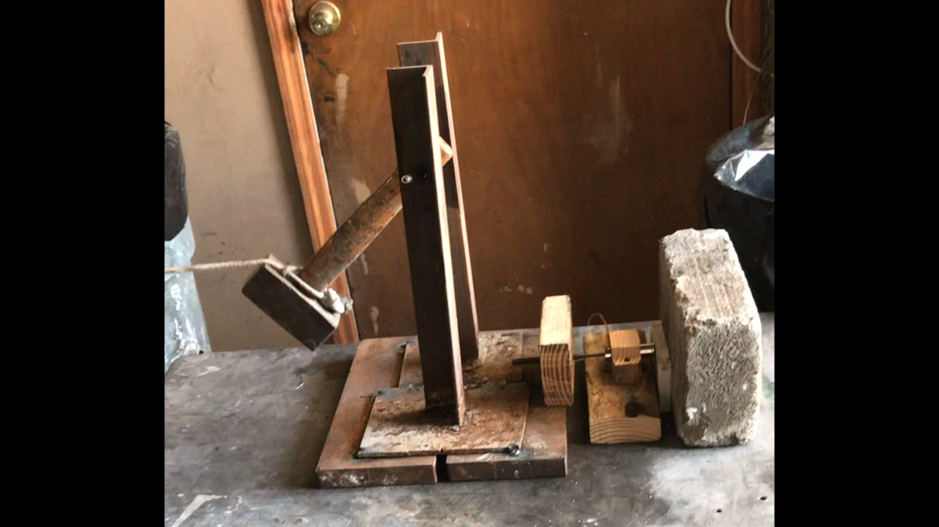
Causes of runaway
Heating (most studies employ)
Puncturing
Internal short (defect)
Charging or discharging malpractice
How does “cause” affect the energy release?

Slide 6
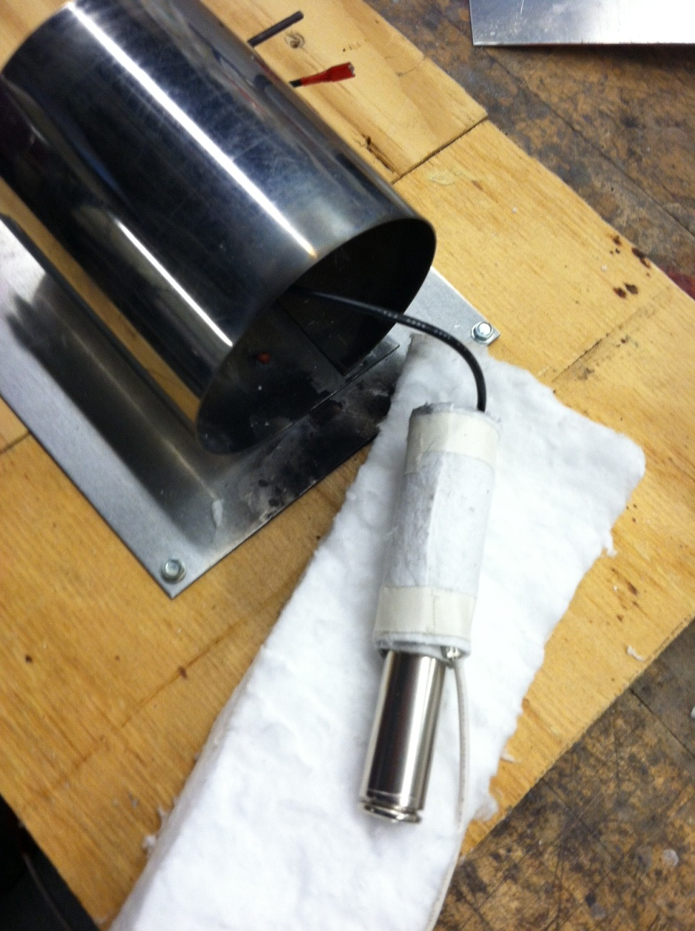
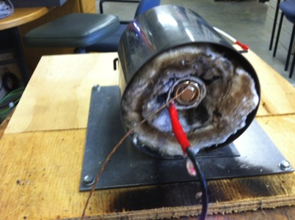
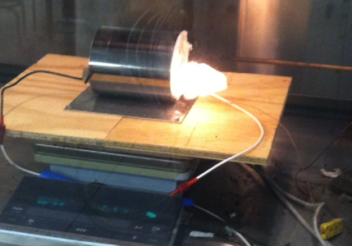
How to measure the runaway energies
Battery calorimeter: Runaway energy

Slide 7
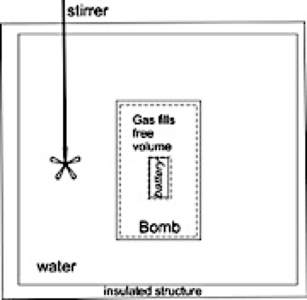
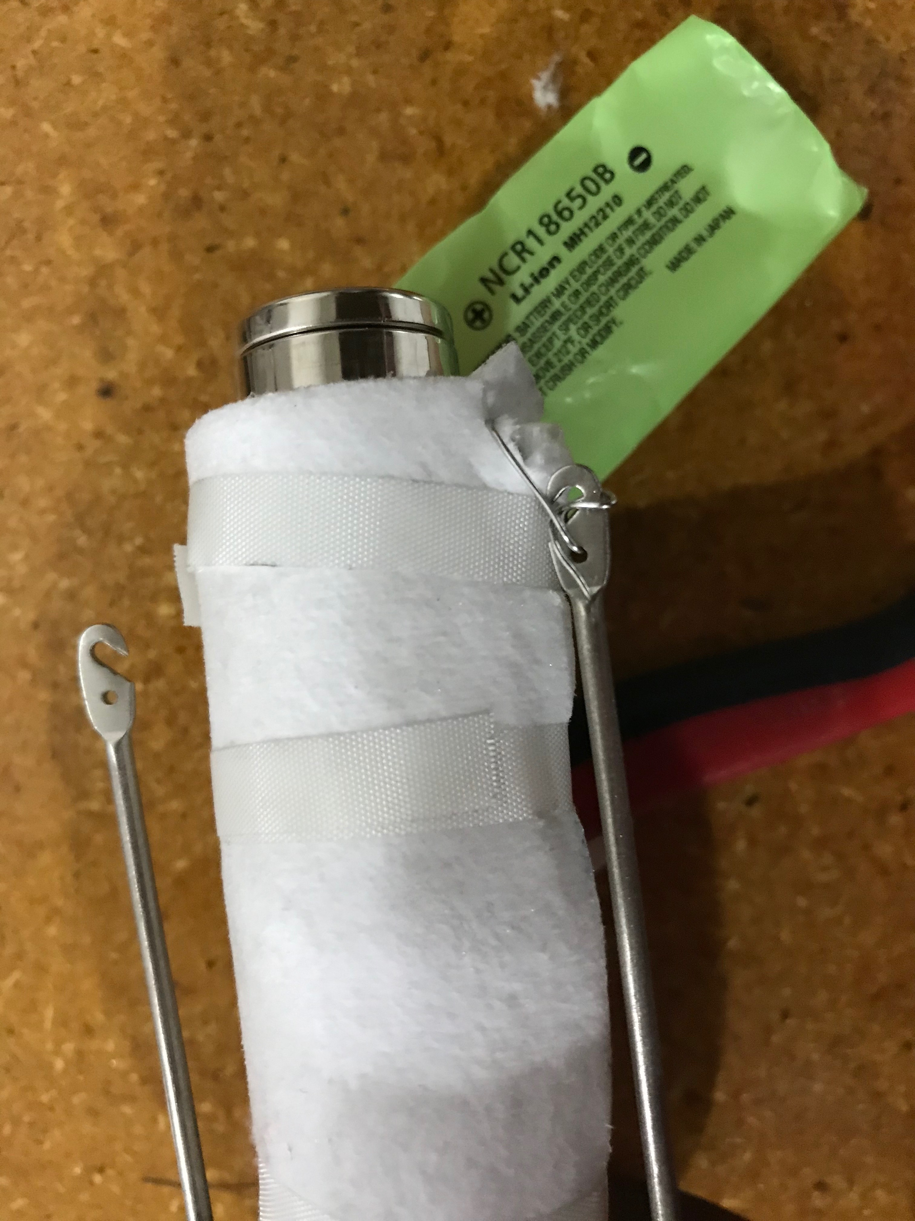
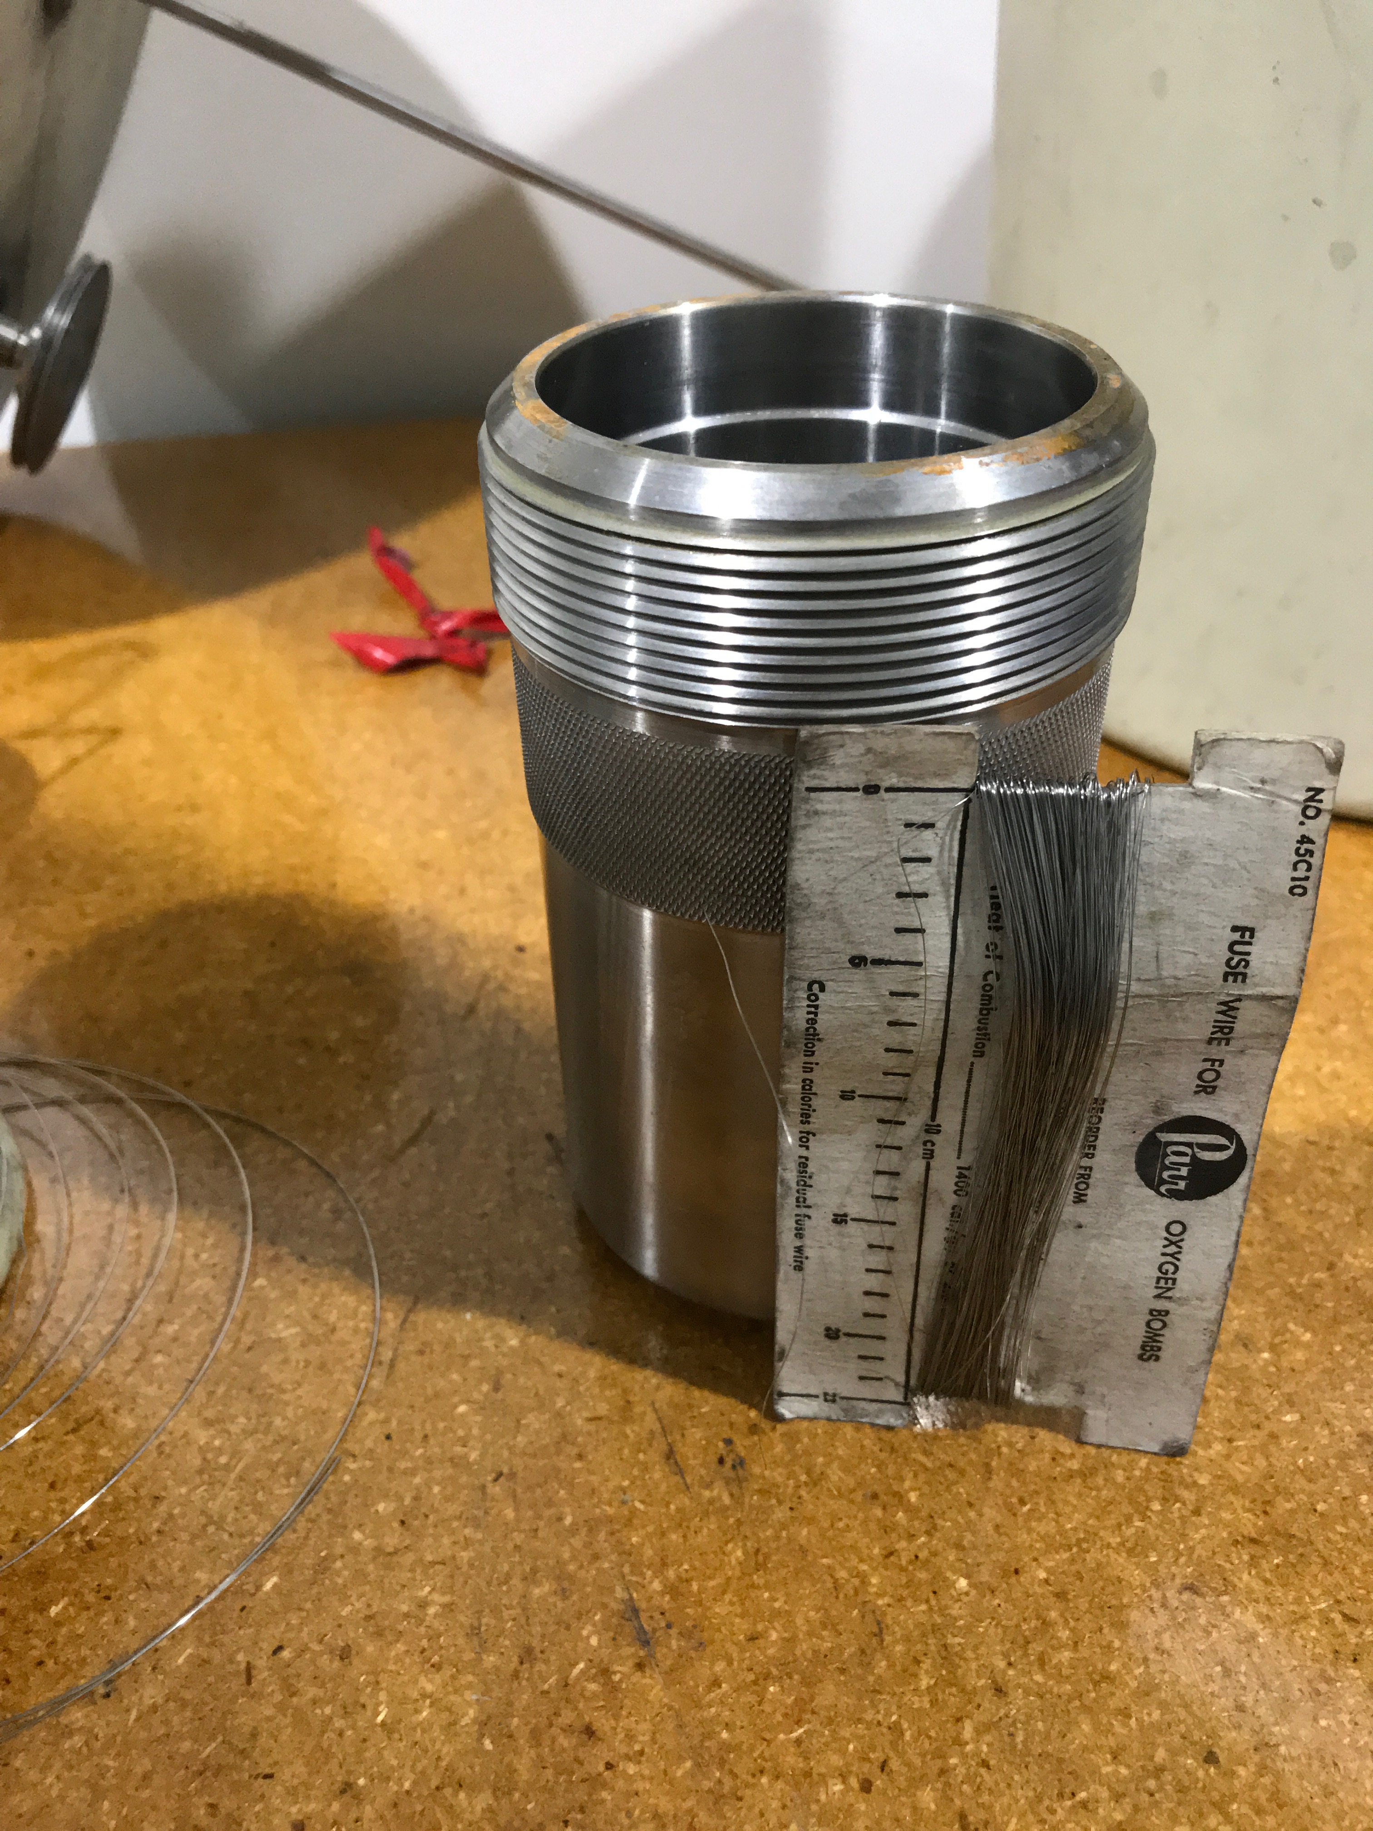
How to measure the runaway energies
Oxygen Bomb: Runaway & combustion energy

Slide 8
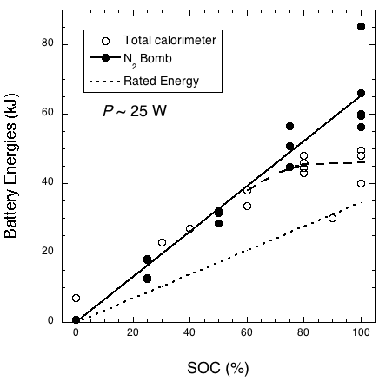
N₂ Bomb and total energy (internal+ejected)
N₂ bomb Lyon & Walters
Battery calorimeter
Internal + ejected
Rated electric

Slide 9
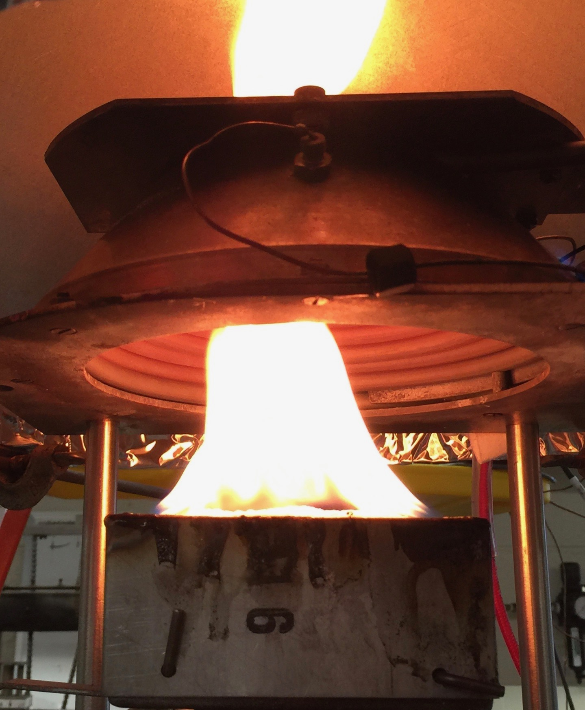
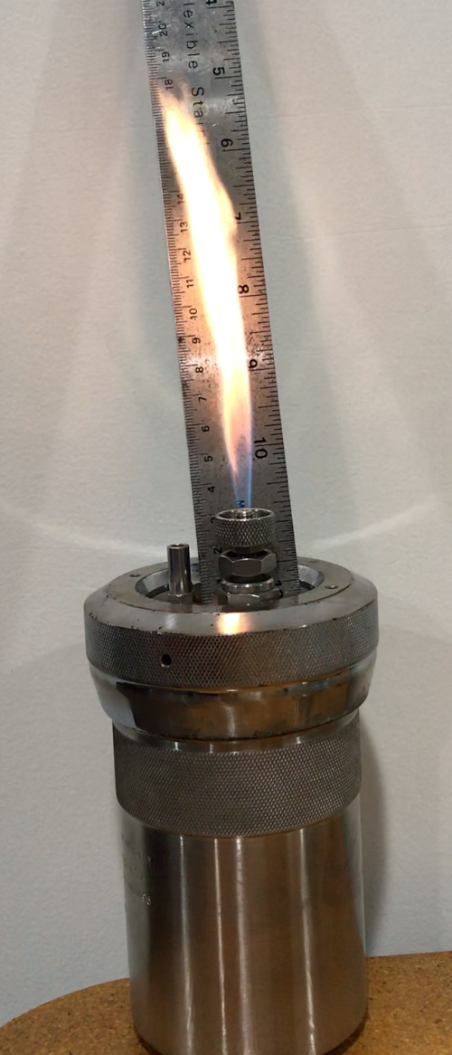

How to measure the runaway energies
Cone calorimeter: combustion energy
Capture exhaust
A lot of chaotic debris
Burn from Bomb

Slide 10
How to measure the runaway energies
Combustible gases from N₂ bomb test, X_{i}: combustion energy
Pp, V, T of measuring vessel,

Slide 11
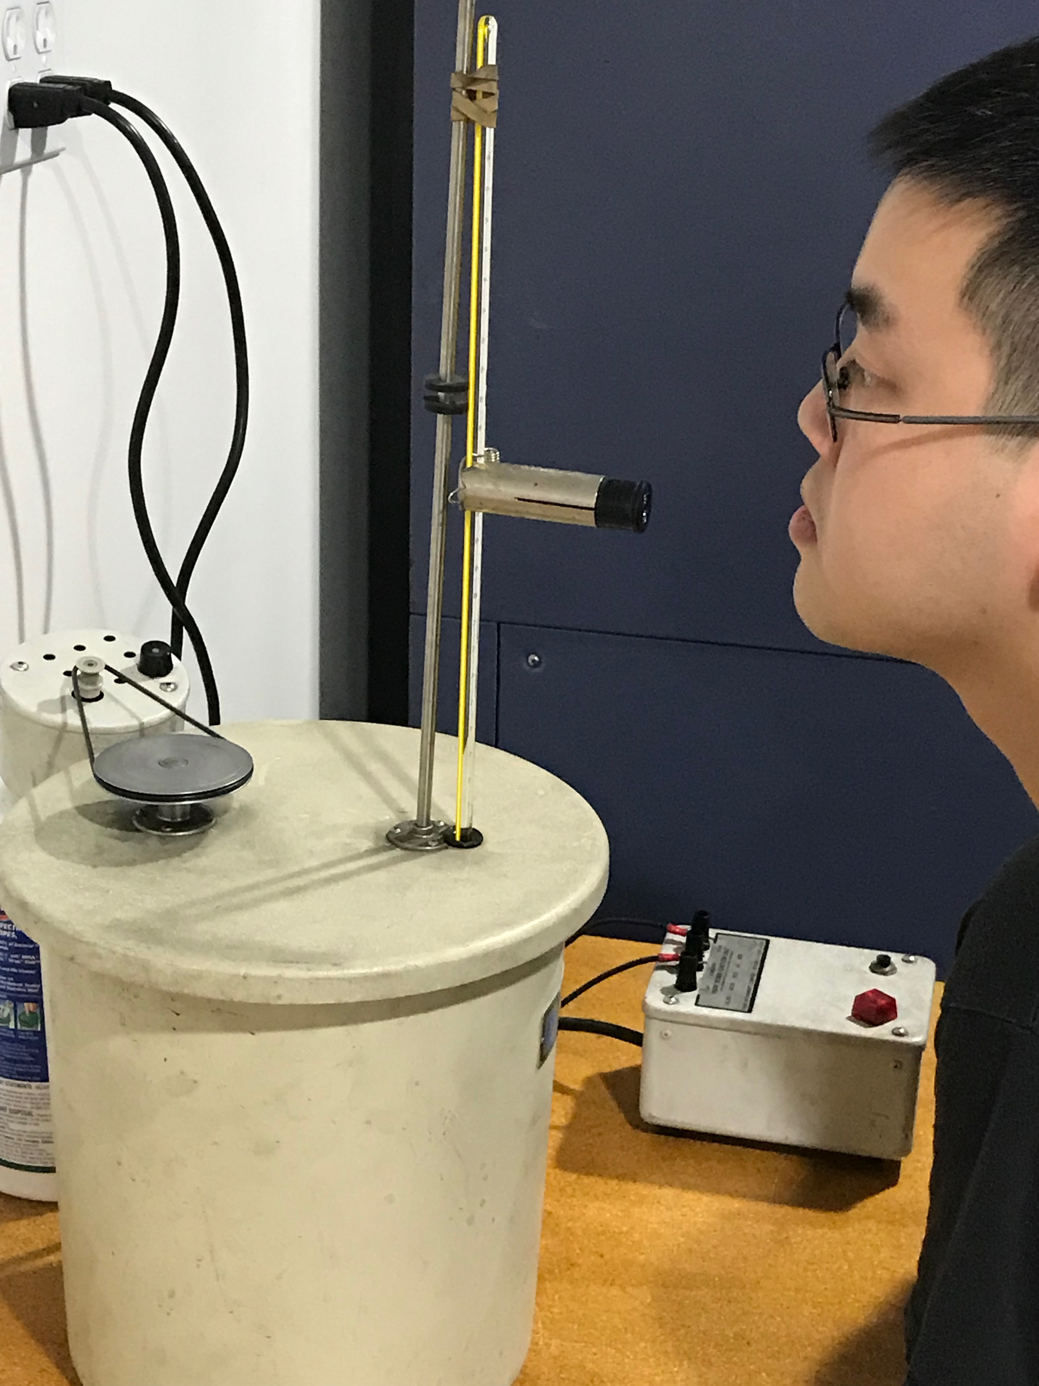
Some comparisons:
  100 % SOC Panasonic NCR18650B Li Mn Ni Co Oxide battery, 3400mA-hr at 3.6 v.
  Measure runaway energy in Nitrogen Bomb
  From Walters and Lyon (FAA TC -15 - 40) who developed the technique
  72 kJ.
  Our work at Vtec
  88.1 kJ

Slide 12
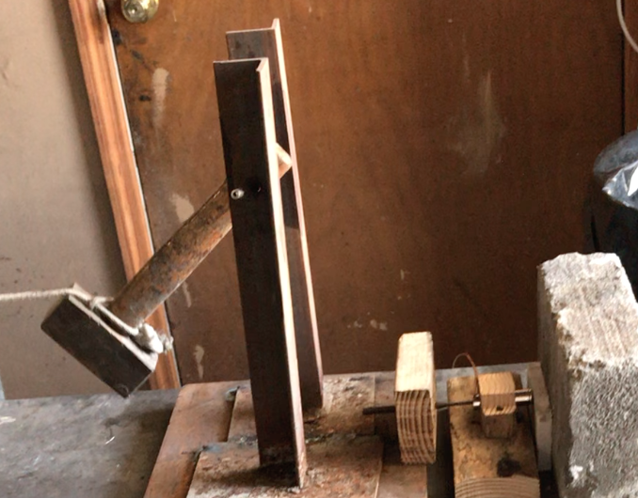
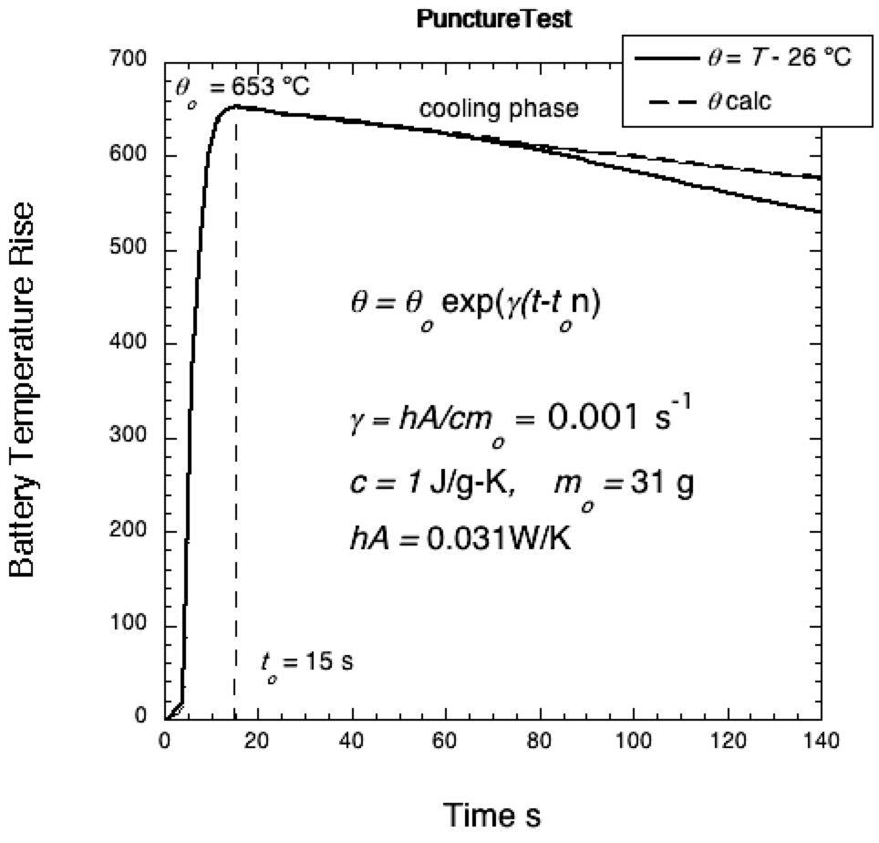
Some comparisons:
  100 % SOC Panasonic NCR18650B Li Mn Ni Co Oxide battery, 3400mA-hr at 3.6 v.
  Runaway energy Puncture Test : 29 - 40 kJ Heating Test: 88 kJ Vtec,, 72 FAA kJ

Slide 13
Some comparisons:
  100 % charged Panasonic NCR18650B Li Mn Ni Co Oxide battery, 3400mA-hr at 3.6 v.
  Measure runaway energy in Oxygen Bomb: Runaway + Combustion
  Vtec for N₂ Bomb: Runaway Energy: 88.1 kJ
  Vtec O₂ Bomb: Runaway + Combustion: 111, 112 kJ
  Igniter wires broke interrupting combustion
  Possibly 112 – 88 = 24 kJ combustion energy (complete?)

Slide 14
Some comparisons: Combustion energy
  Tenergy LiCoO₂ 18650 (2600 mA-hr) battery at 100 % SOC
  Estimate from combustion gases (Maloney FAA TC-15/59) 50 or 64 kJ
  m_{i} from X_{i}, p, V, T of vessel
  From Cone (Crowley, et al FAA TC-15/17) 48, 55 kJ

Slide 15
Where are we?
Adopting N₂ Bomb method of Walters and Lyon to measure runaway energy.
Adopting GC measurement technique of Maloney to measure combustion energy & check with Cone.
Will select batteries for validation of measuring techniques.
Will select a range of battery capacities to develop data as a function of initial electric energy.
Will establish a basis for containing these energies in packaging.

